Slide 1
Jenkins and Docker
Java Back End

Slide 2
Set Up Jenkins

Slide 3
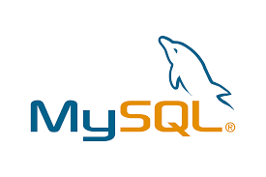
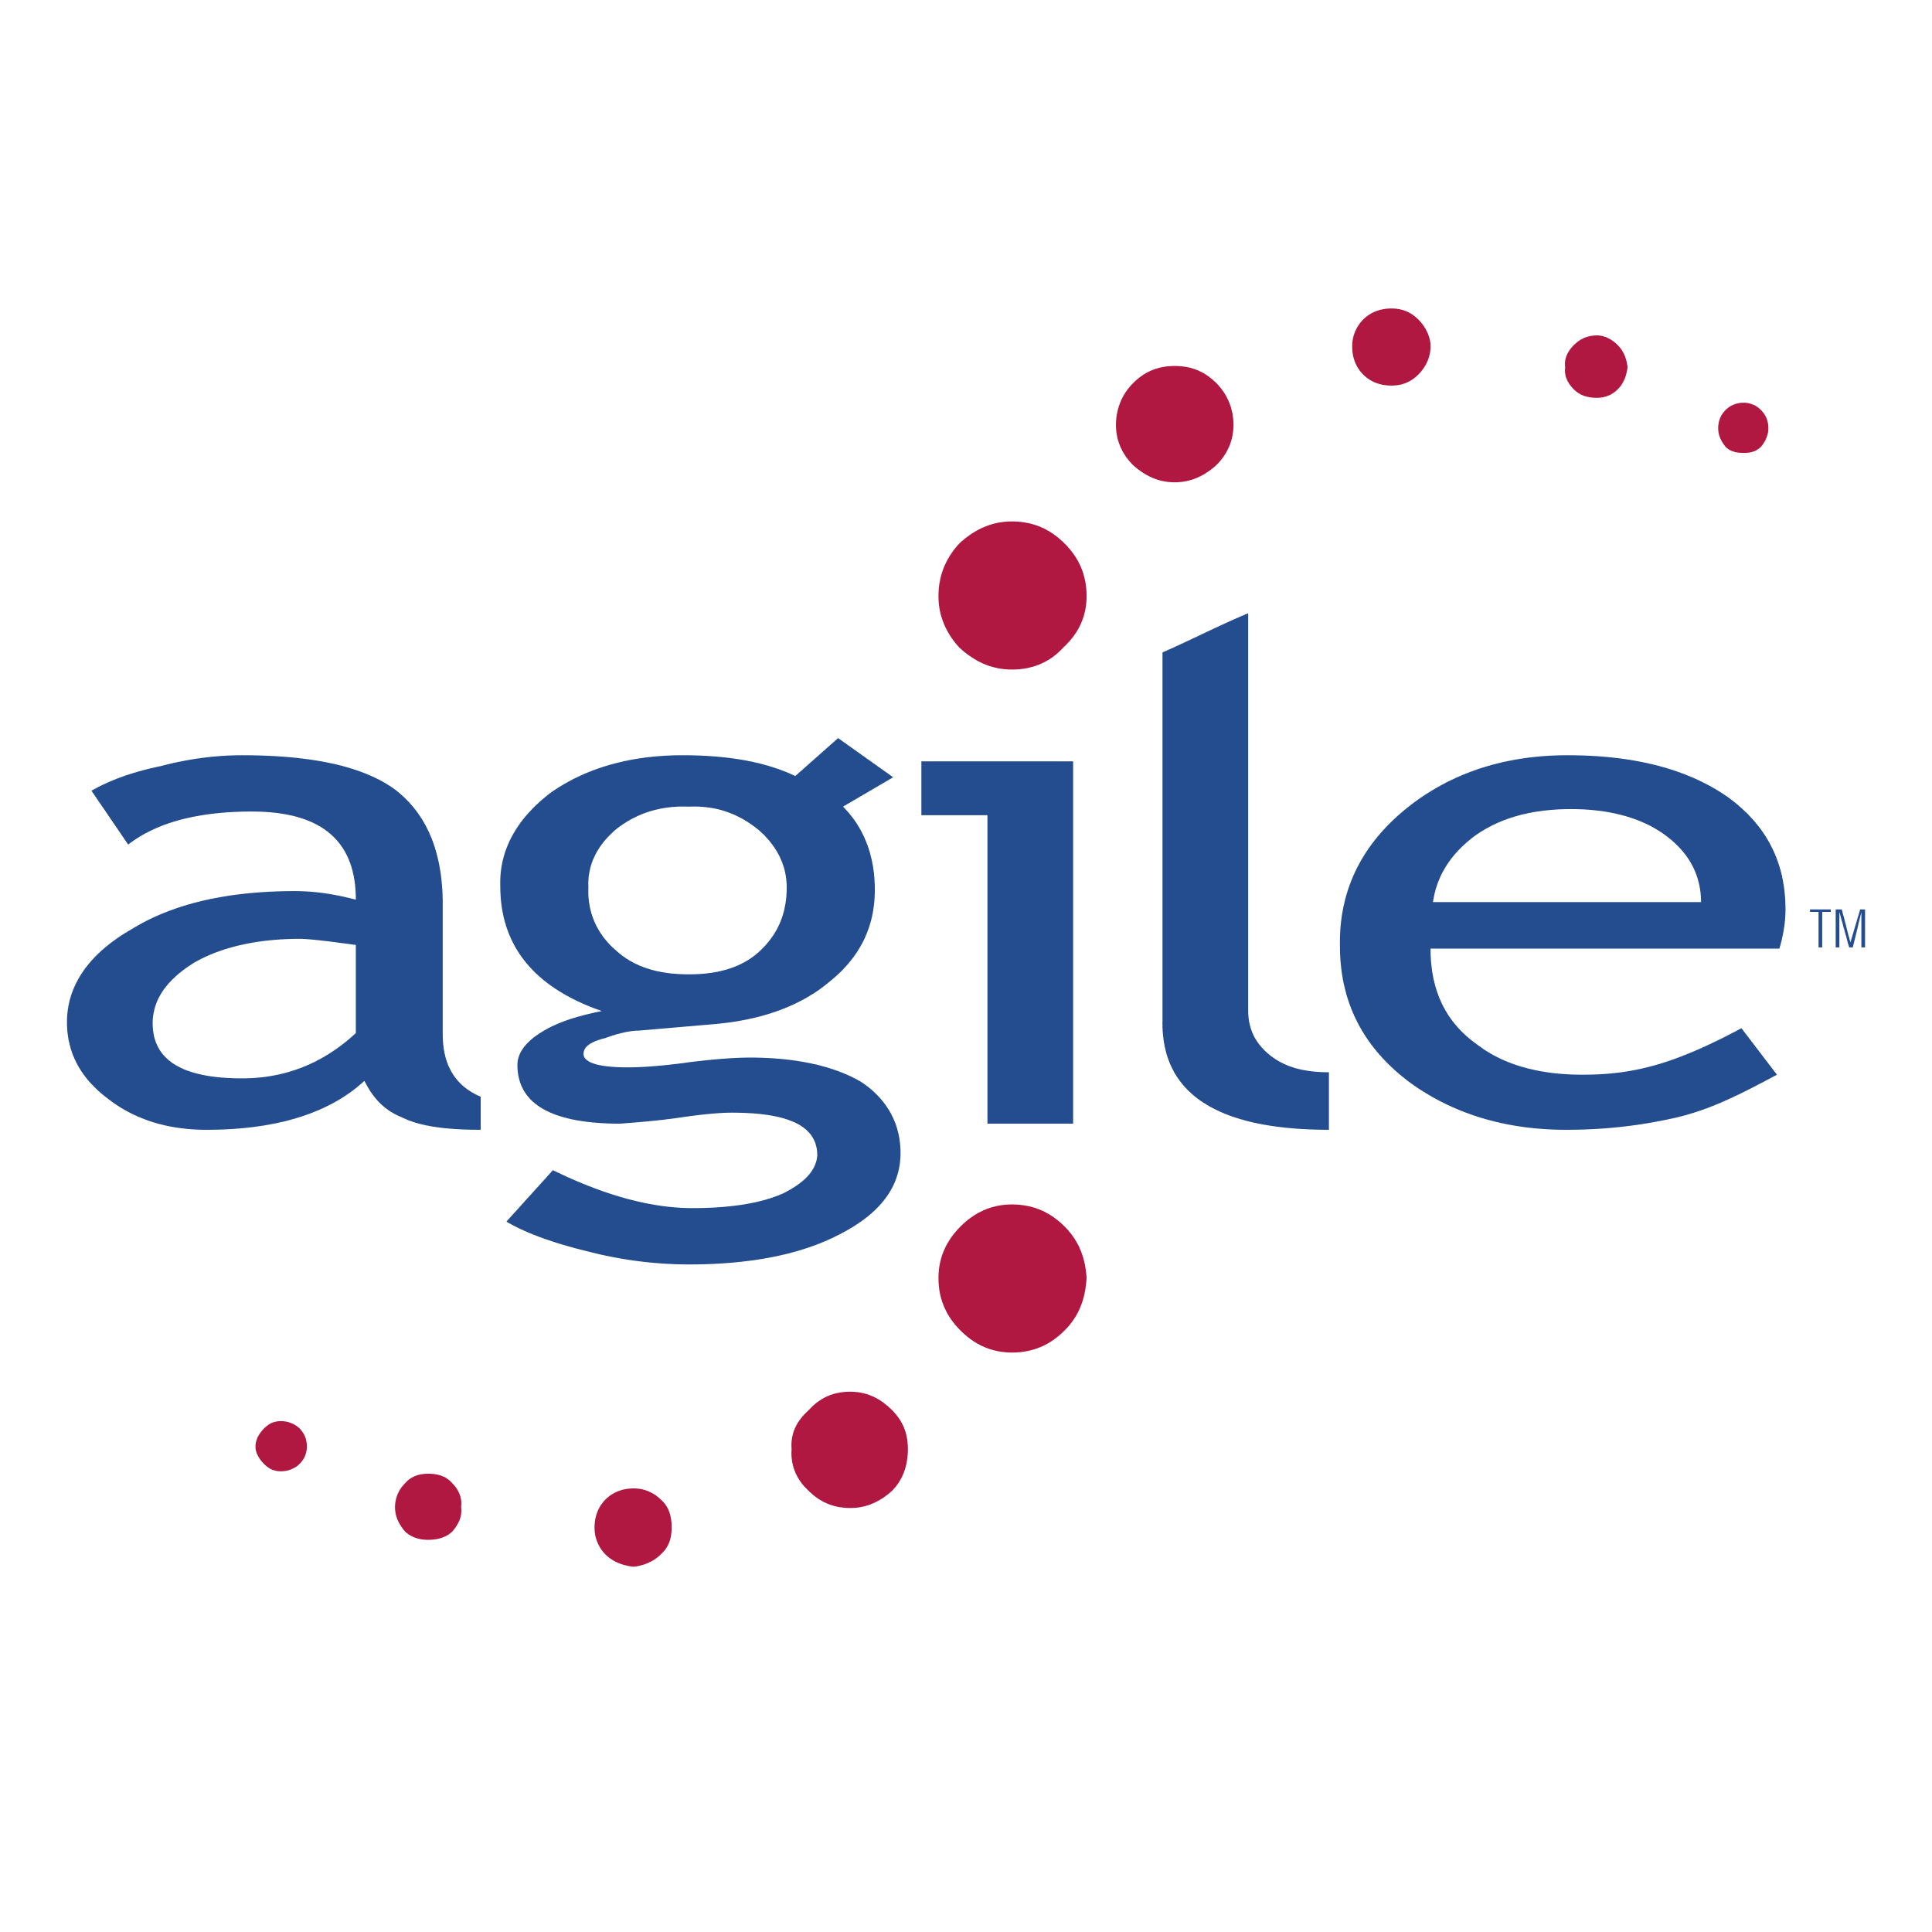
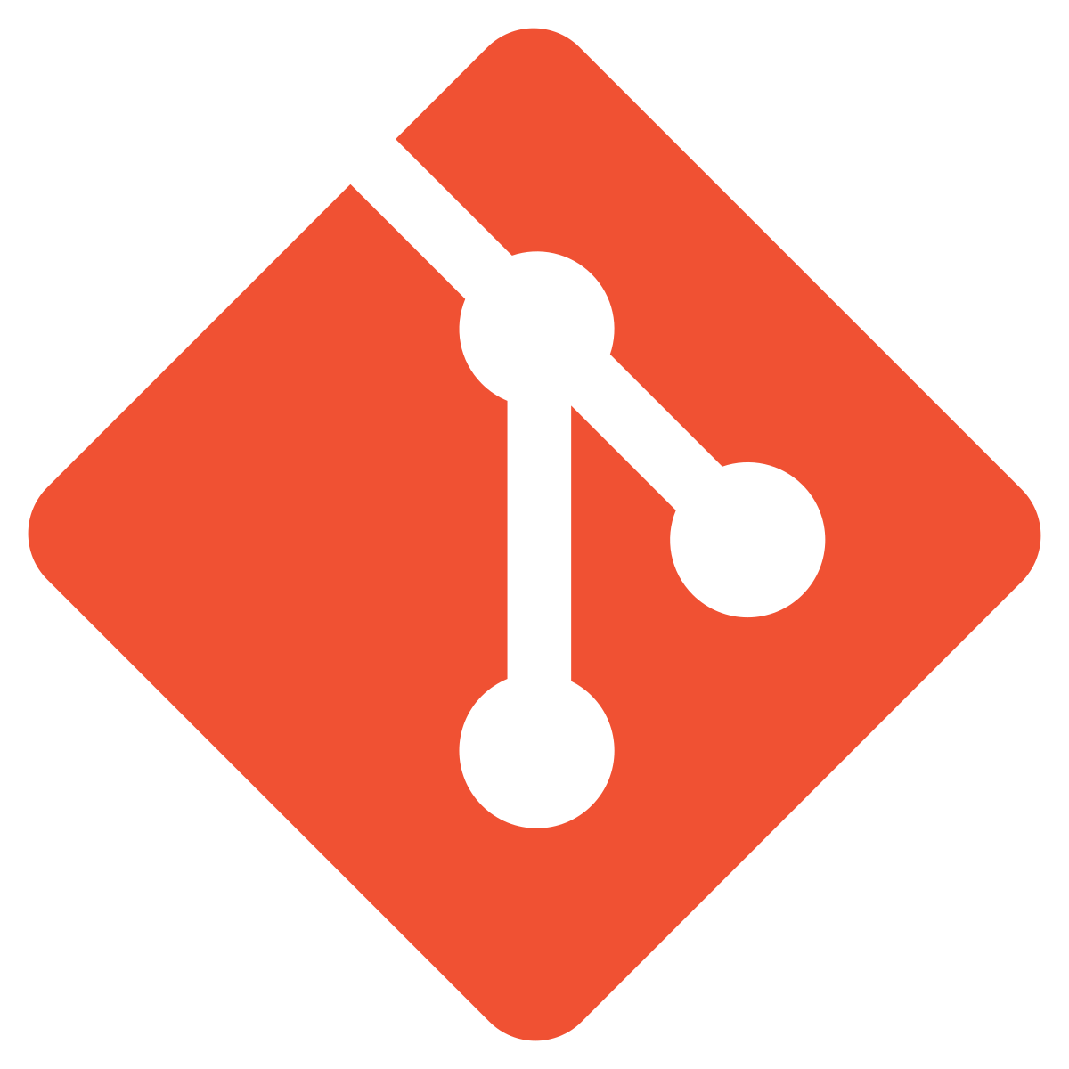
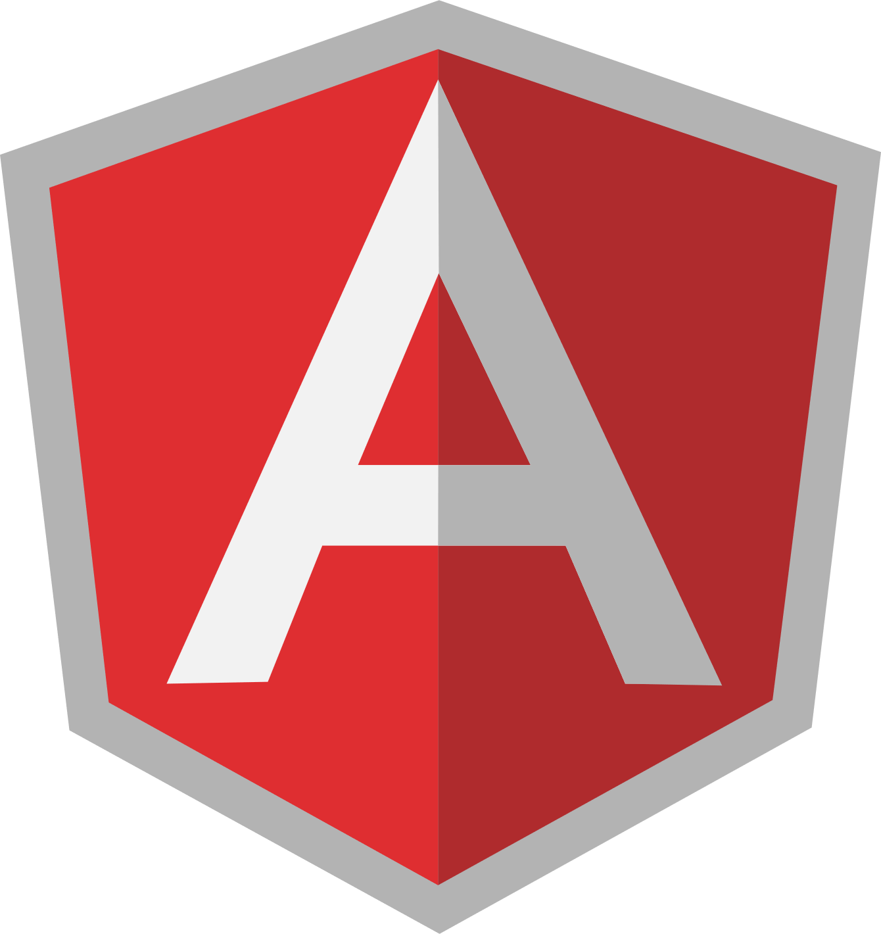
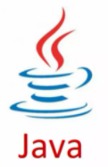
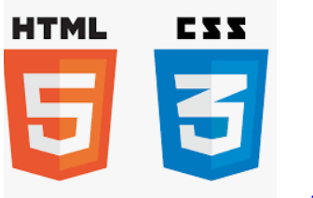

Before we begin, let’s recall what we have covered till now:
Agile
Git
SQL
Angular
HTML
CSS
JavaScript
Core Java

Slide 4
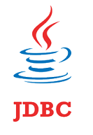

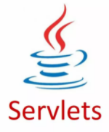


Before we begin, let’s recall what we have covered till now:
JDBC
JSP
Servlets
MongoDB
Maven

Slide 5

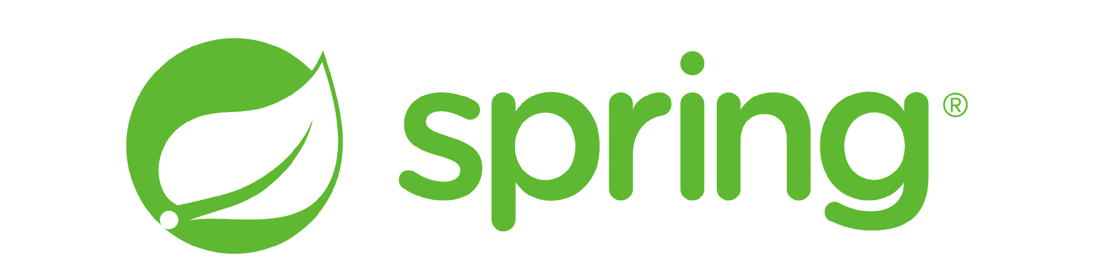
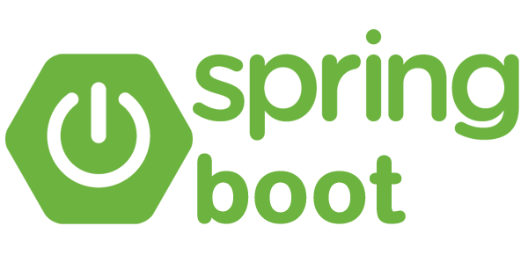
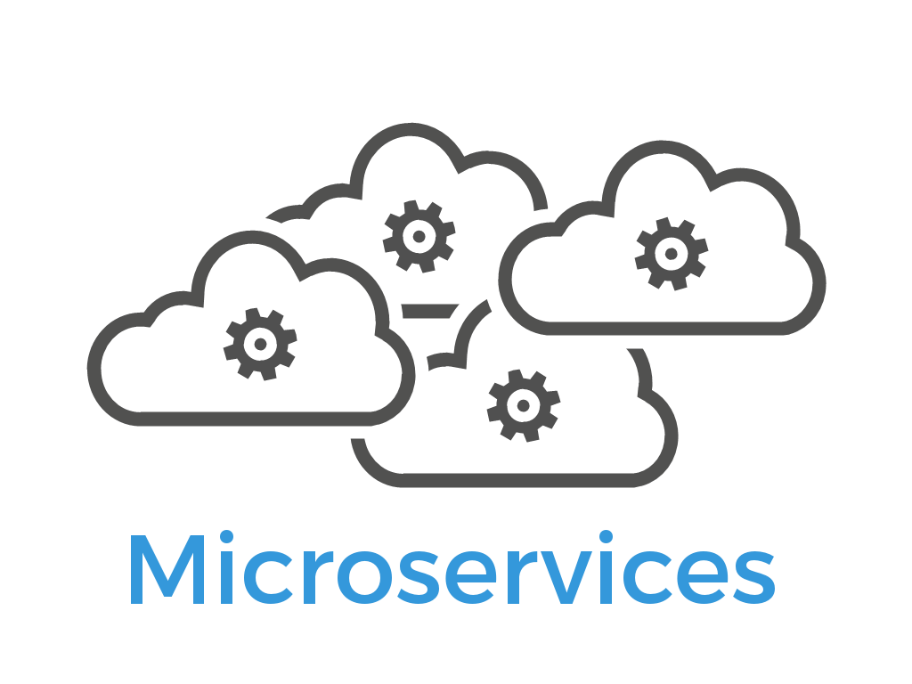
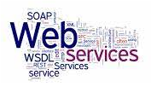
Before we begin, let’s recall what we have covered till now:
JUnit
Spring
Spring Boot
Webservices
Microservices

Slide 6
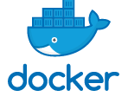
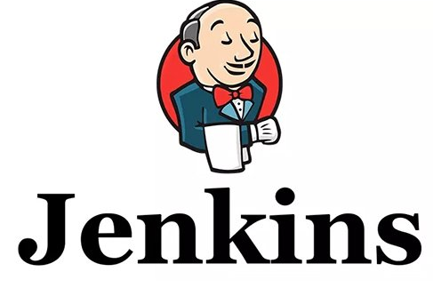

Before we begin, let’s recall what we have covered till now:
Docker
Jenkins
AWS

Slide 7
Developed Angular Front End
Created various components and services for the Angular eStore admin and end user.
Developed Java Back End
Developed the Java back end for the admin and end user
Implemented microservices with Spring Boot
Front End Back End Communication
Used HTTP Client in Angular to communicate with Java back end
Implemented communication for both admin and end-user projects

Slide 8
As a full stack web developer, our key role is to develop both client and server software.
Angular and Node can be used to build the front end
of the web page.
Spring Boot, Java, and MySQL/MongoDB
can be used to build at the back end.

Slide 9

Bob needs to develop a Java back end. He brainstorms a bit and finds a solution.
Let me use Jenkins, Docker, and AWS to build CI/CD Pipelines, containerize the apps, and finally host them to AWS EC2 instance.
In this lesson, we will create Jenkins Pipeline for CI/CD for Java back end. Moving ahead, we will create Dockerfile to build images and run them as containers in Docker and help Bob complete his task effectively and quickly.

Slide 10

Create Jenkins Pipeline for Java back end
Implement CI/CD in Jenkins with Git
Create Dockerfile for building images
Integrate Docker in Jenkins to build and release the images as containers

Slide 11
Set Up Jenkins for the Java Backend Project
Notes:
Now, let us set up the Jenkins environment where we need to create the Java Backend project using Jenkinsfile for the build.
You must have Jenkins installed on your lab to create the Jenkins Pipeline project.

Slide 12
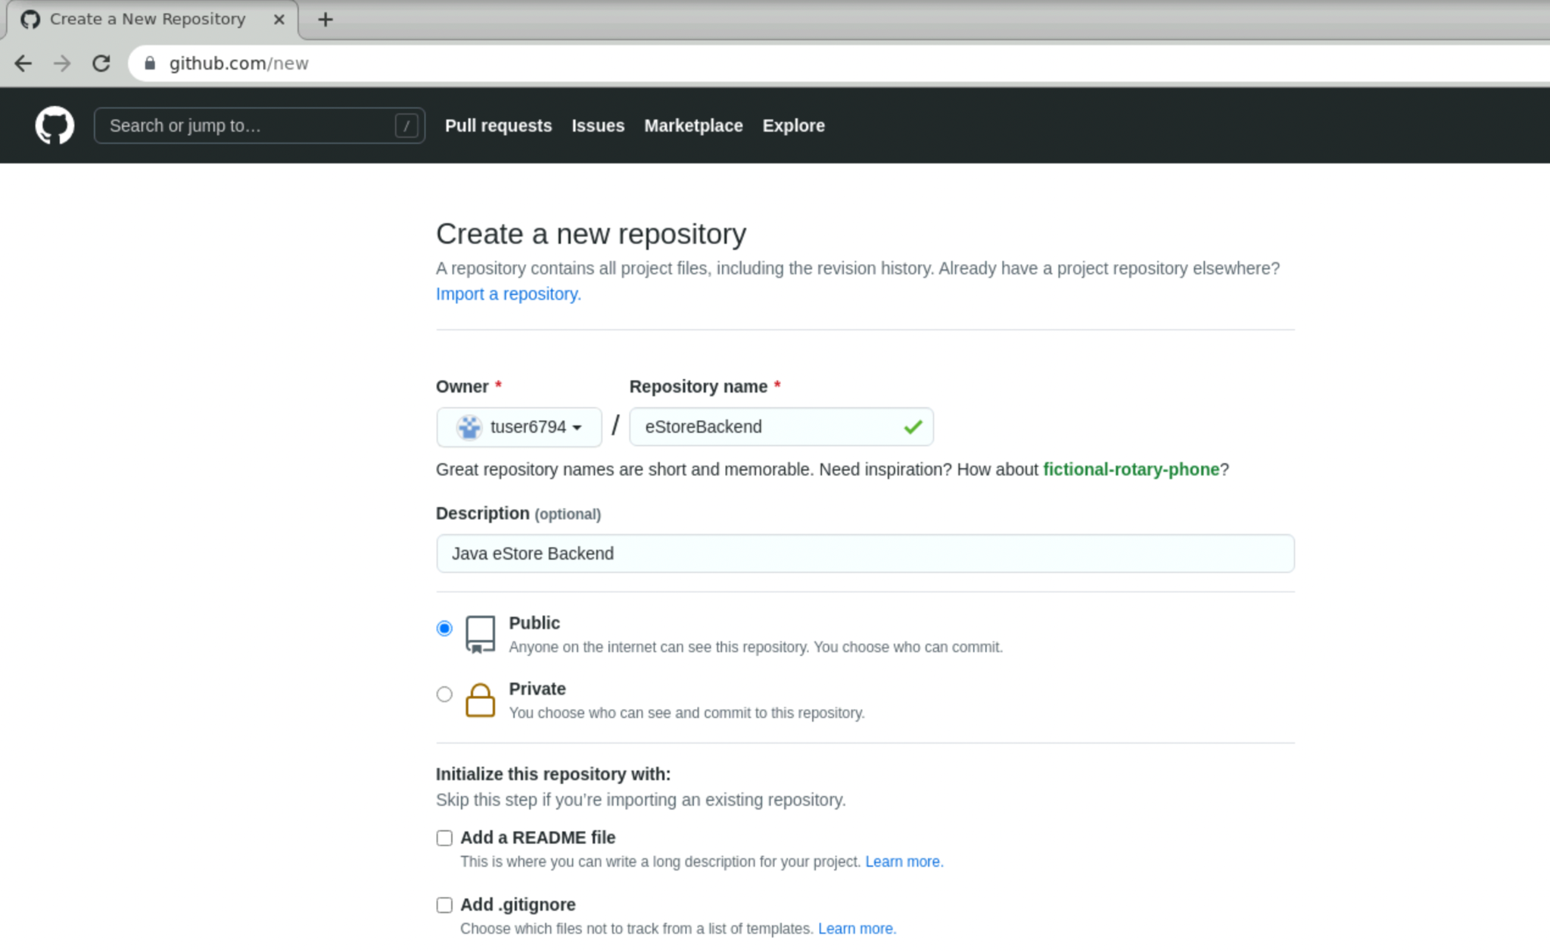
Create Git Repository on GitHub for the Java Backend Project
Create a new repository on your GitHub account which will be used by Jenkins to sync the code in SCM.
Notes:
Create a new repository on your GitHub account. This will be used by Jenkins to sync the code in SCM.

Slide 13
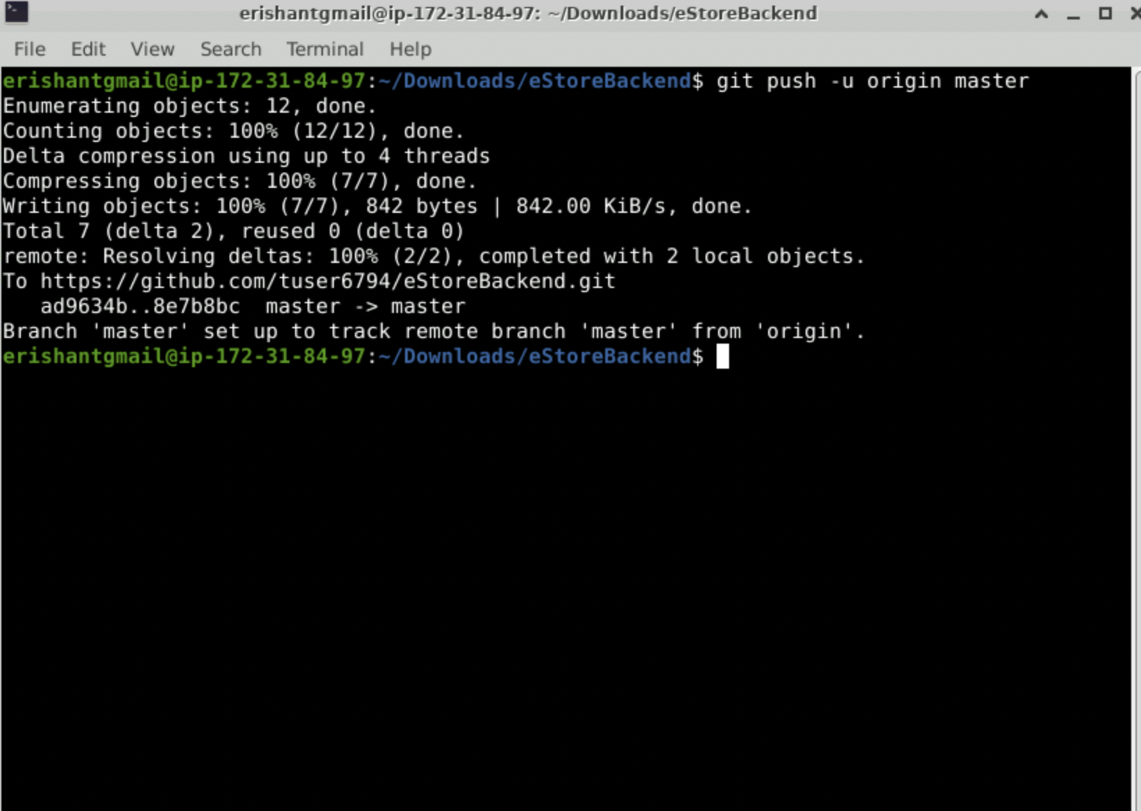
Sync the Project on Github for Java Backend Project
Push the code on GitHub for the Java Backend project.
Notes:
Push the code on GitHub for the Java Backend project.

Slide 14
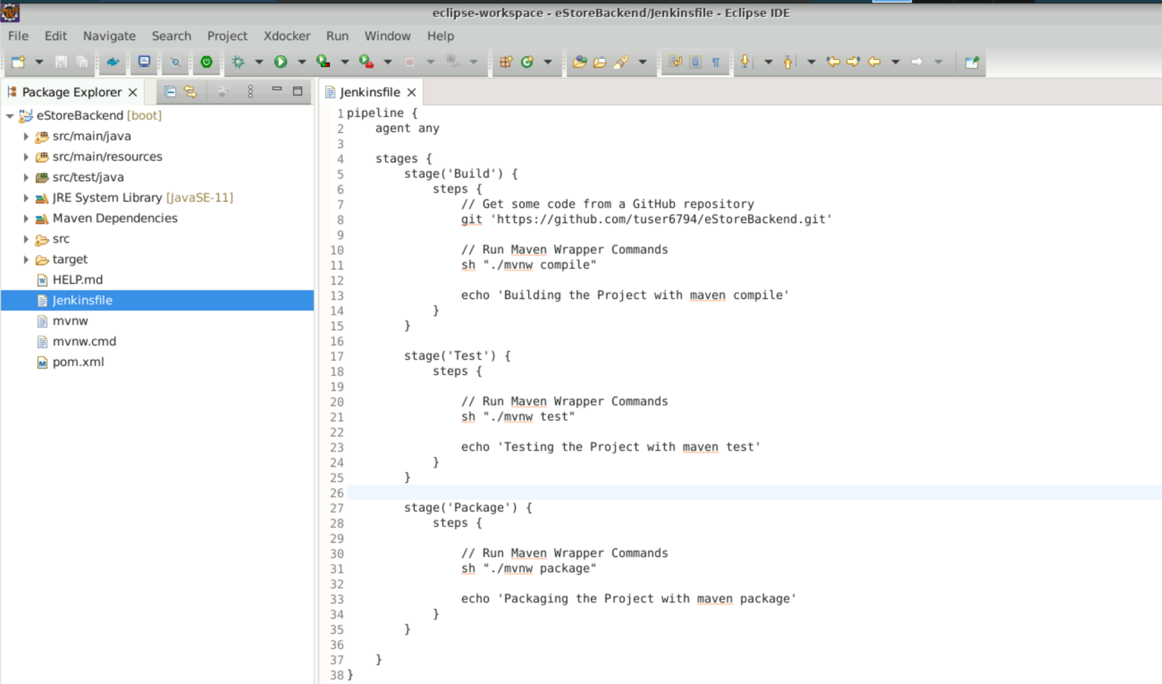
Configure Jenkins Pipeline Stages for the Java Backend Project
Create a Jenkinsfile for Jenkins to build your project as Pipeline in Jenkins.
Create it in root directory of project and push it to GitHub so that Jenkins Project can use Jenkinsfile for Pipeline.
Notes:
Now, create a Jenkinsfile for Jenkins to build your project as Pipeline in Jenkins.
We will create it in the root directory of the project and push it to the GitHub so that Jenkins Project can use Jenkinsfile for the Pipeline

Slide 15
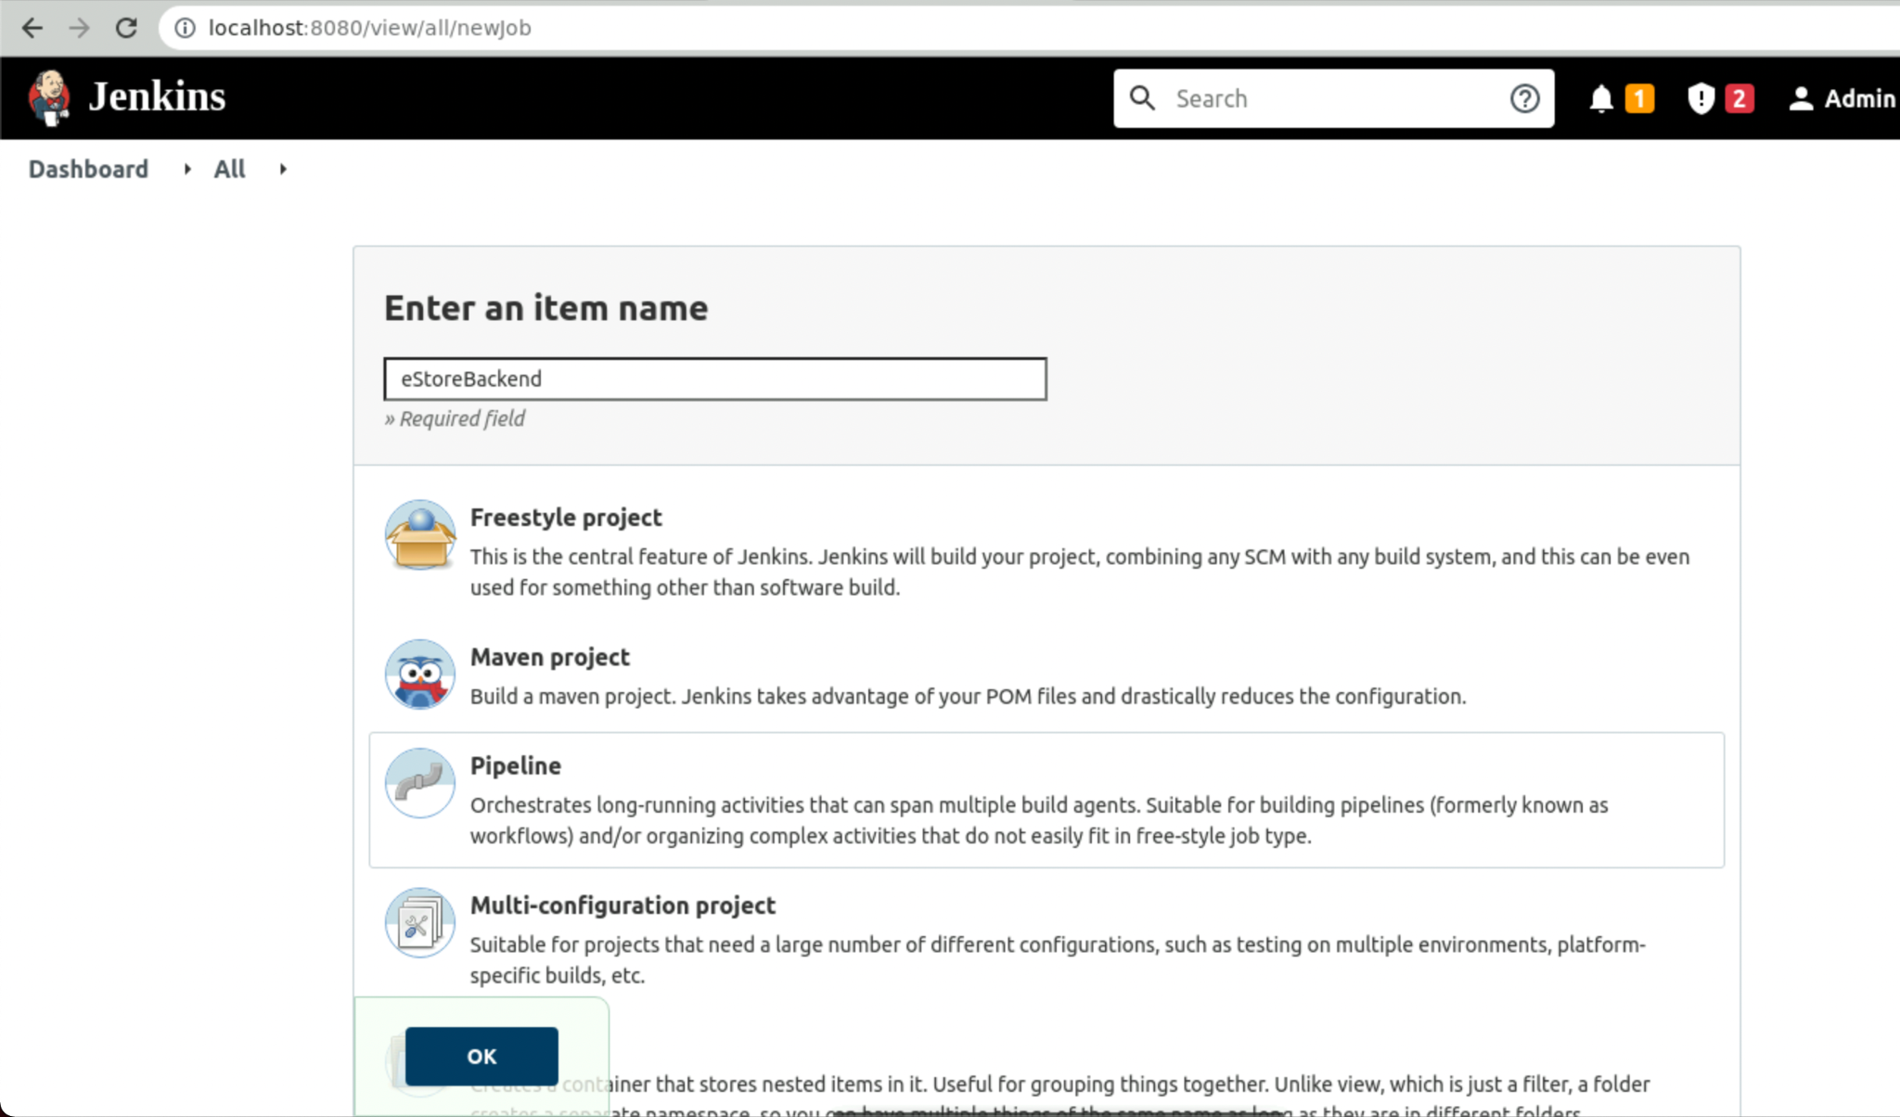
Create a Jenkins Pipeline Project for the Java Backend Project
Create a new project in Jenkins of type Pipeline.
Notes:
Create a new project in Jenkins of type Pipeline.

Slide 16
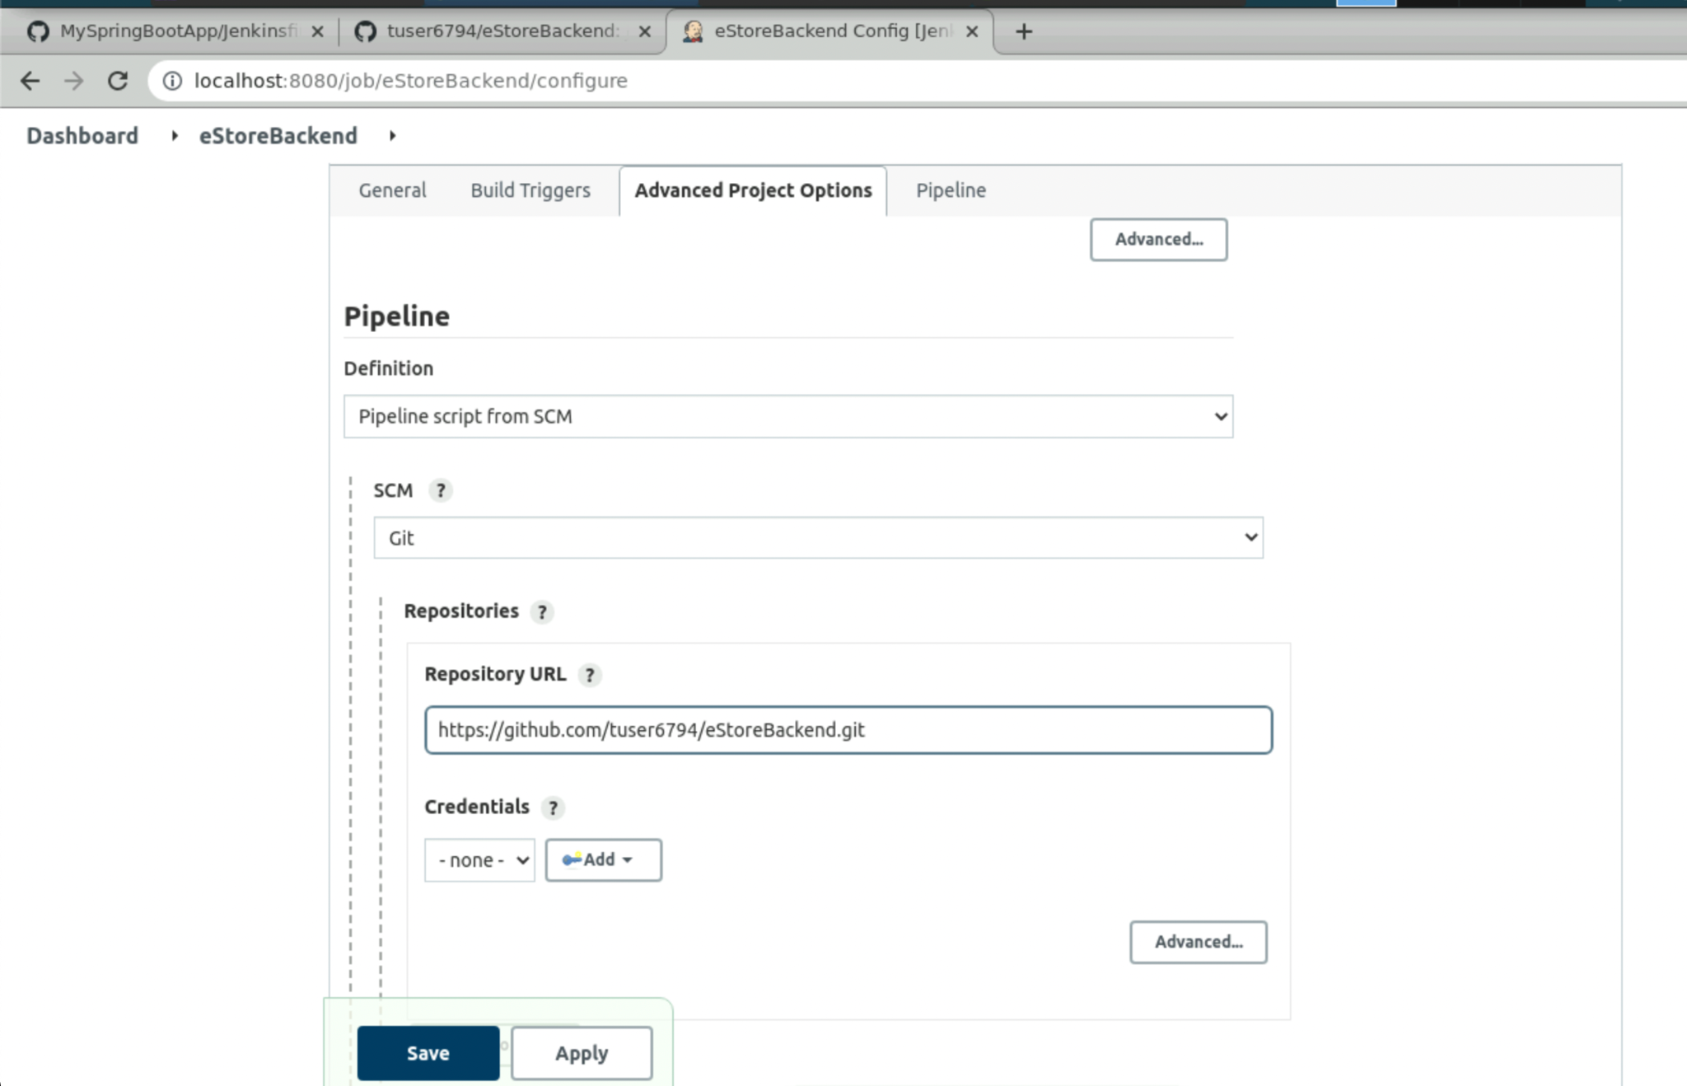
Configure Jenkins Pipeline SCM for the Java Backend Project
Configure the Jenkins Pipeline Project by passing GitHub Repository URL.
Notes:
Configure the Jenkins Pipeline Project by passing GitHub repository URL.

Slide 17
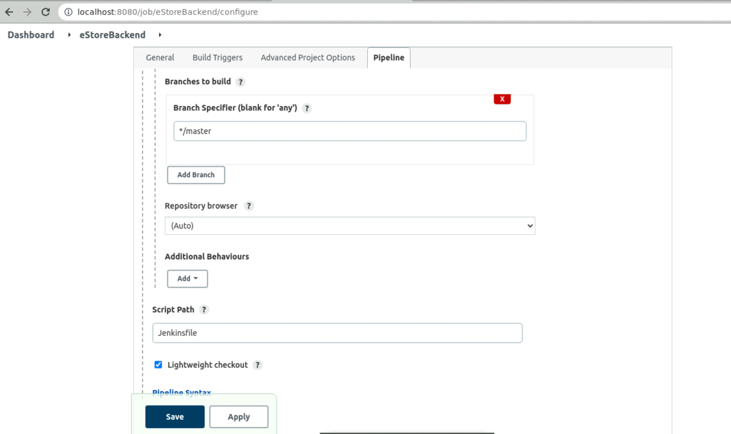
Configure Jenkinsfile in Jenkins for the Java Backend Project
From the branch specifier, select the branch.
Select the default branch, which is master.
The Script Path contains the Jenkinsfile, which is created in the root directory of project.
Notes:
From the branch specifier, select the default branch, which is master.
The Script Path contains the Jenkinsfile which is created in the root directory of our project.

Slide 18
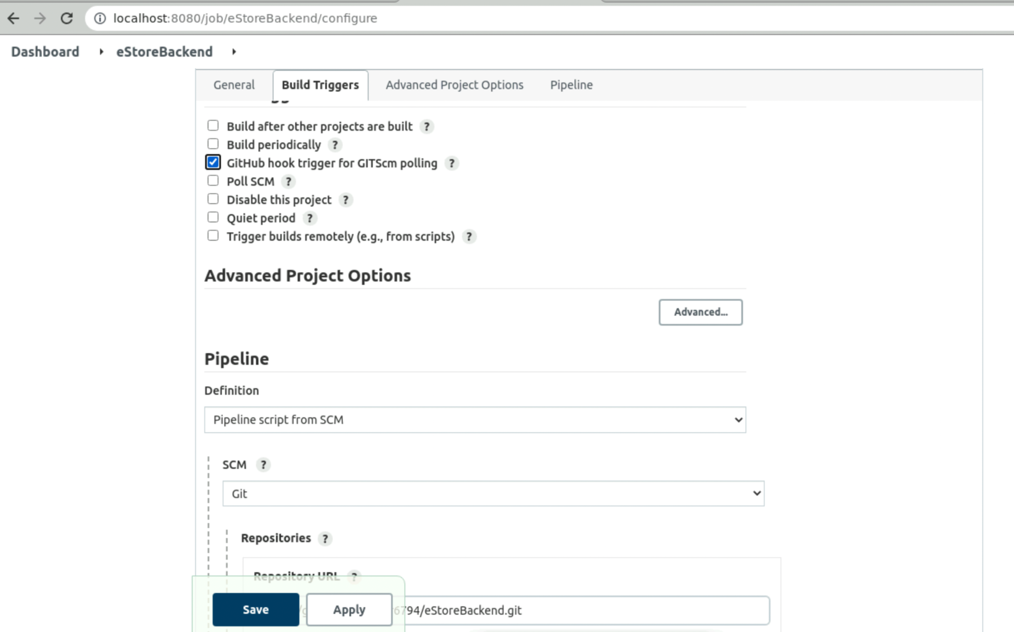
Optional: GitHub Hook Trigger for the Java Backend Project
Configure GitHub trigger for GITScm Polling. This option will work when Jenkins is running with a proper URL instead of the localhost.
Configure the same using ngrok.
Notes:
Optional Step
Configure GitHub trigger for GITScm Polling. This option will work when Jenkins is running with a proper URL instead of the localhost
You can configure the same using ngrok.

Slide 19
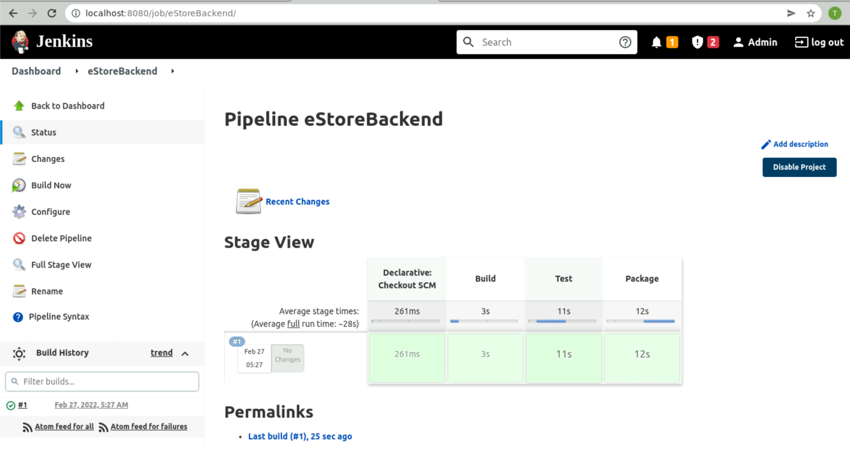
Run the Jenkins Pipeline Project for the Java Backend Project
Notice stages appearing as mentioned in the Jenkinsfile.
Source > Test > Build > Containerize > Deploy
Finally, click on Build Now and build your project.
Notes:
Finally, click on Build Now and build your project
You will notice the stages appearing as we mentioned in the Jenkinsfile
Source > Test > Build

Slide 20
Dockerise the Pipeline

Slide 21
Containerize the Java Backend Project
Notes:
For Java back end, let us write the Dockerfile which will build the image for our Backend project.

Slide 22
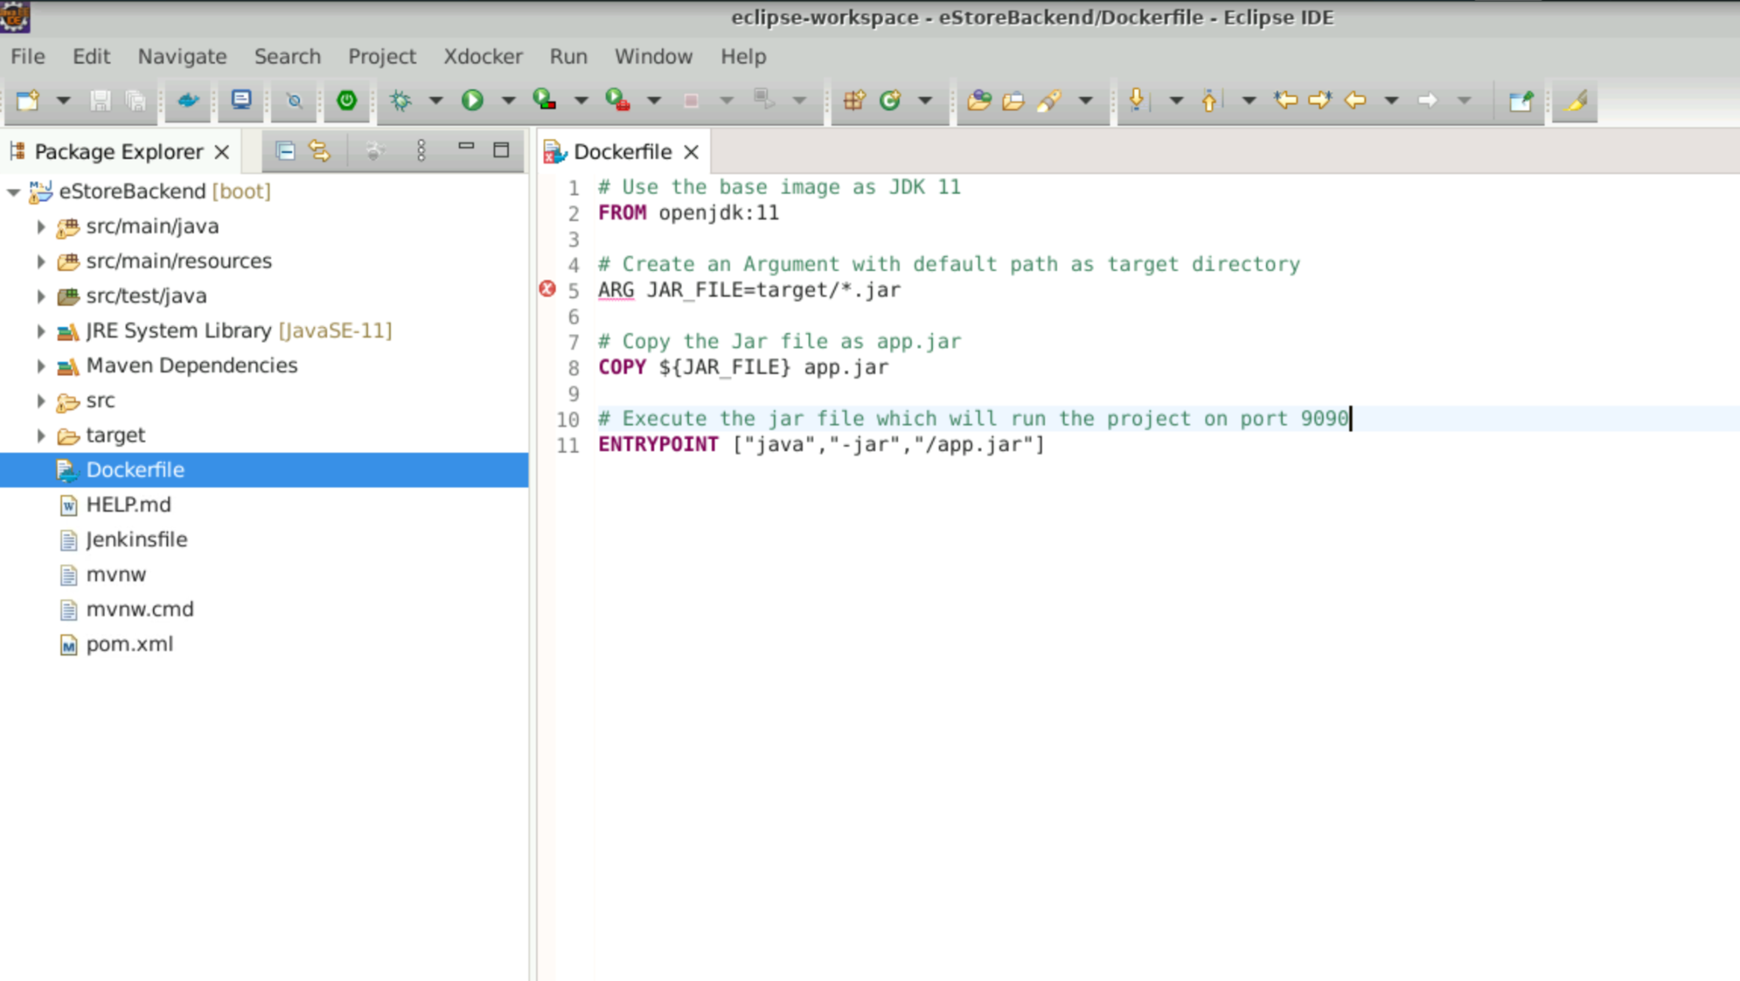
Configure Docker Using Dockerfile for Java Backend Project
Write the Dockerfile which will be used to dockerize Java for the Backend project.
Build the jar file of Java Backend project for production.
Serve the application by executing the Jar on port 9090.
Notes:
Let us write the Dockerfile which will be used to dockerize Java for the Backend project
The Dockerfile will perform the following steps:
Build the jar file of Java Backend Project for production.
Serve the application by executing the Jar on port 9090.

Slide 23
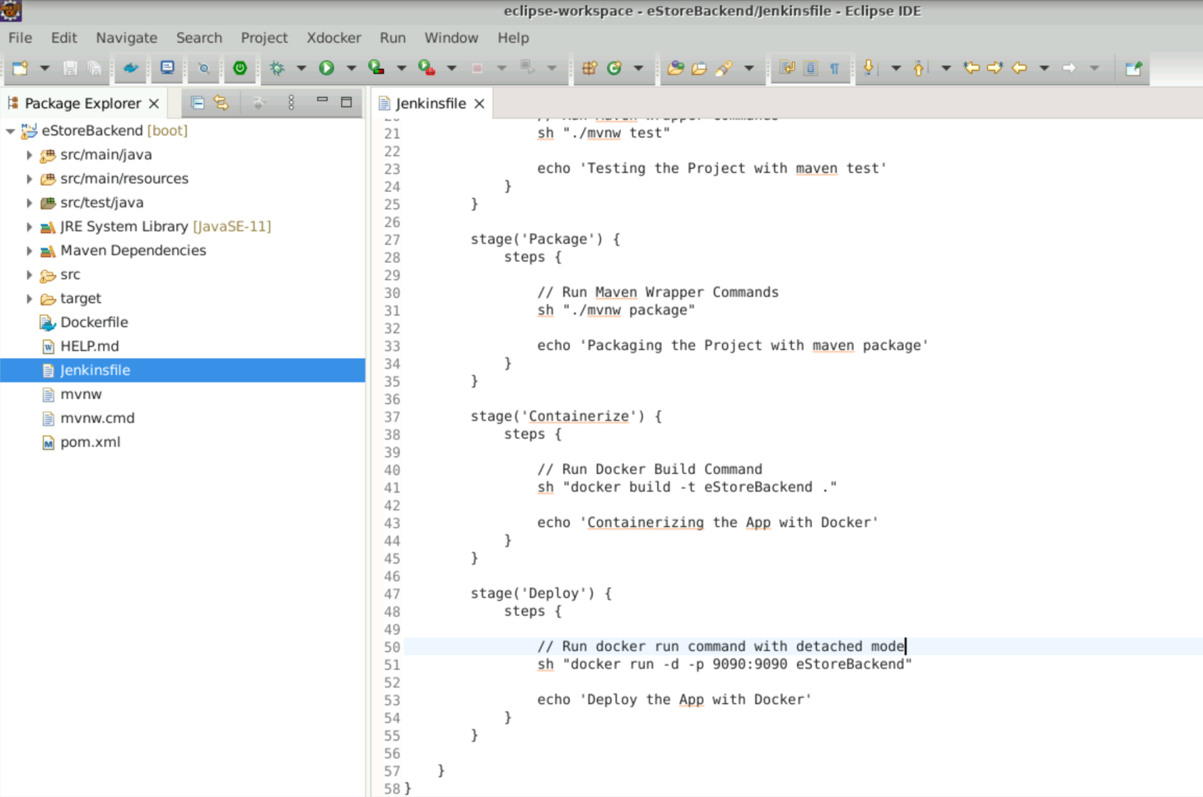
Configure Jenkins Pipeline Stages for Java Backend Project
Add the stages for containerizing the Java Backend that is building and running the container finally.
Create it in root directory of project and push it to the GitHub so that Jenkins project can use Jenkinsfile and Dockerfile.
Notes:
Now, in the already created Jenkinsfile, let us add the stages for containerizing the Java Backend i.e. building and running the container finally
We will create it in the root directory of the project and push it to the github so that Jenkins Project can use Jenkinsfile and Dockerfile

Slide 24
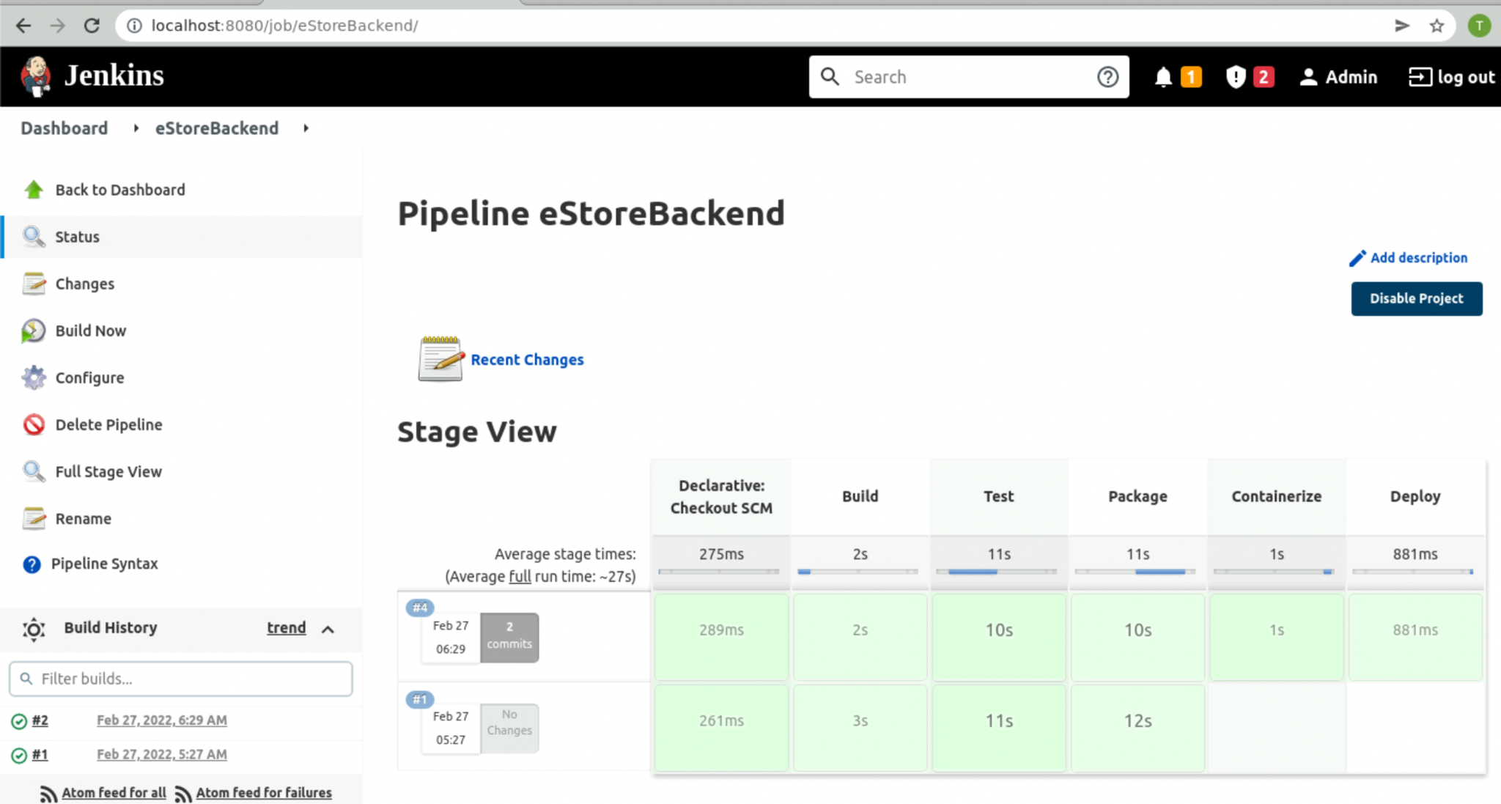
Run the Jenkins Pipeline Project for Java Backend Project
Notice stages appearing as mentioned in the Jenkinsfile.
Source > Test > Build > Containerize > Deploy
Click on Build Now and build your project.
Notes:
Now, click on Build Now and build your project
You will notice the stages appearing as we mentioned in the Jenkinsfile
Source > Test > Build > Containerize > Deploy

Slide 25
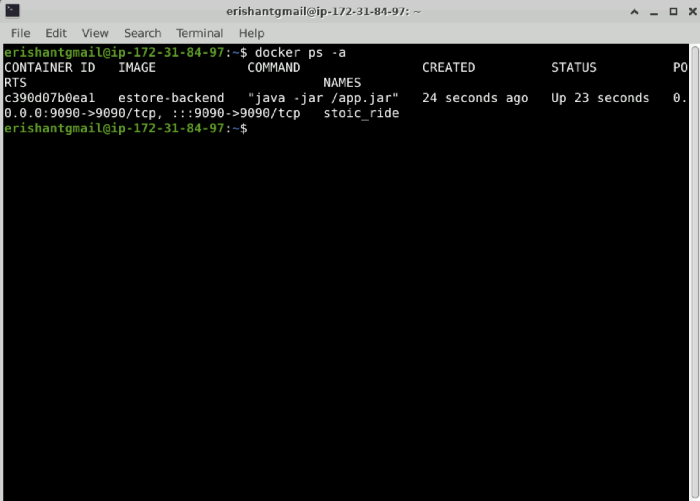
Check Docker ps -a
Check status of running container by docker ps –a,
which is the command to validate Jenkins build.
Notes:
You can check the status of the your running container by docker ps - a command to validate the Jenkins build.

Slide 26
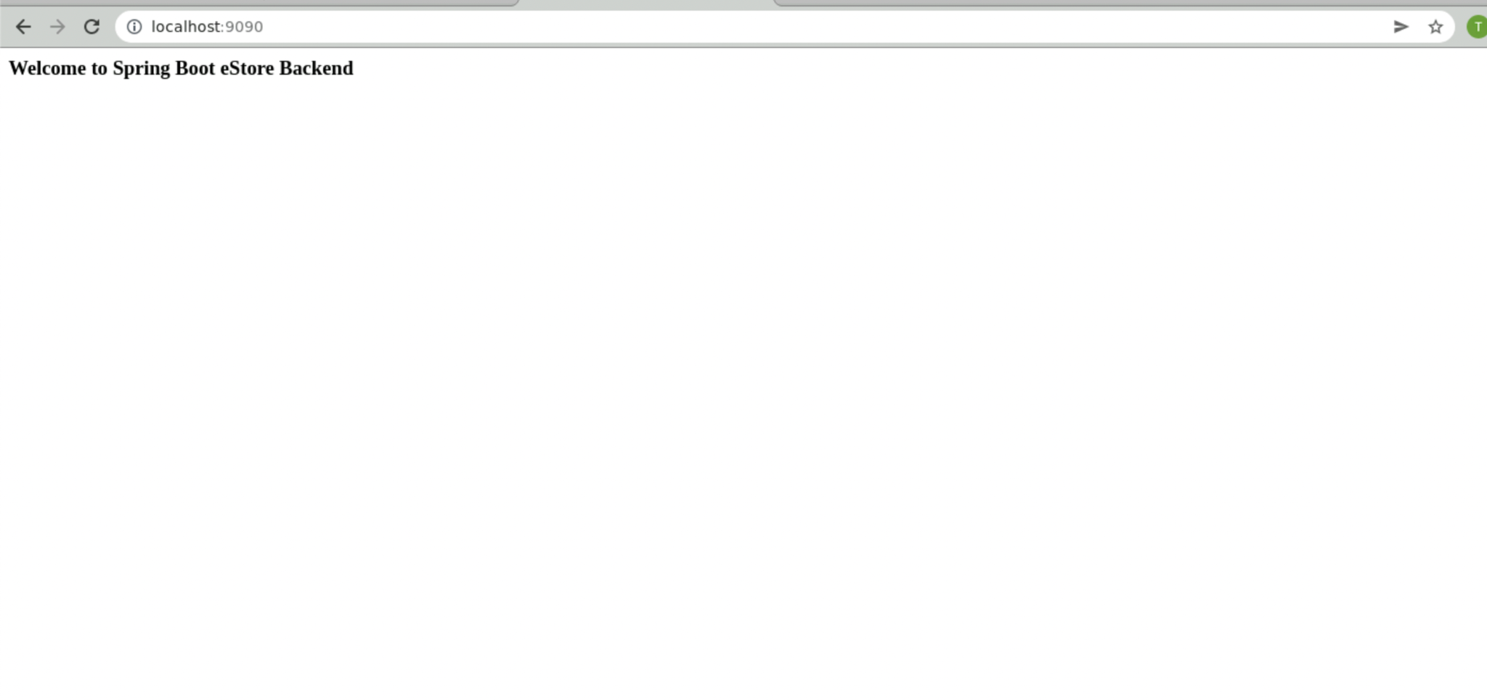
Check the Backend Project on Localhost
The Backend project is up and running in the docker container.
Notes:
The web-admin project is up and running in the docker container.

Slide 27
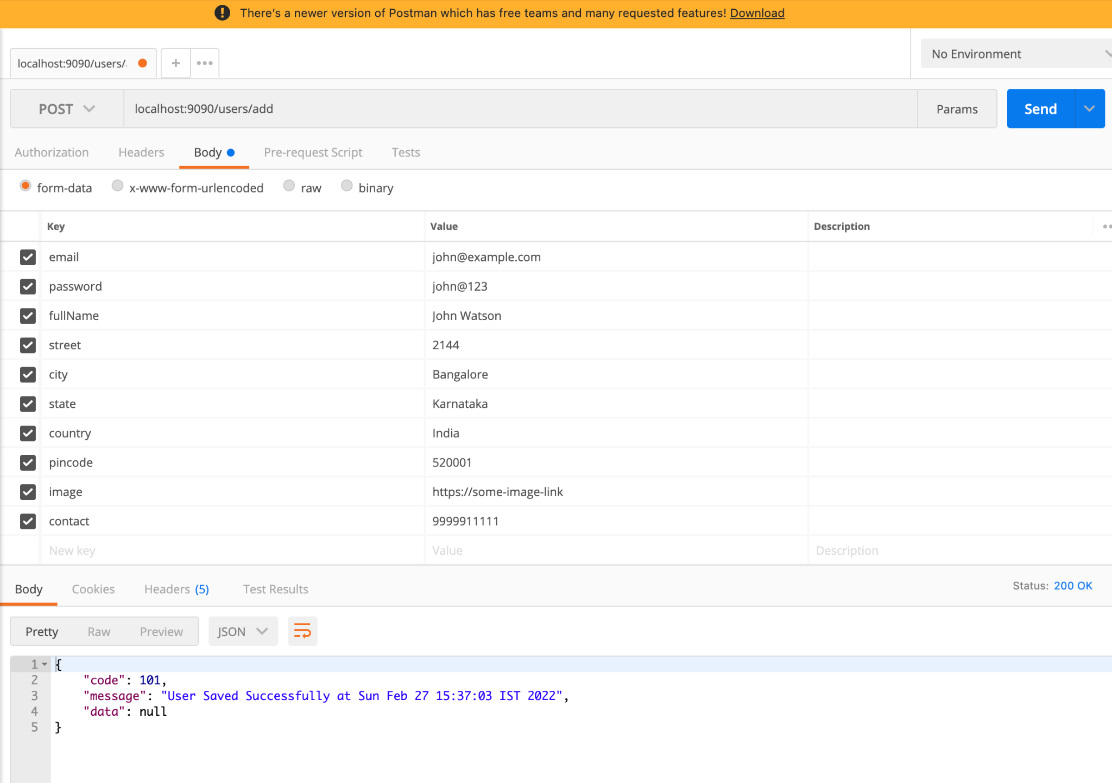
Check Service on Postman
Validate if the project is up with services running.
Notes:
Let us validate if the project is up with services running

Slide 28
Jenkins Pipeline is built for Java Back end using Jenkinsfile.
Java back end is dockerized using Dockerfile.
Jenkins Pipeline is built to dockerize the Java back end.
Service is validated using Postman.

Slide 30
Which stage will create the jar file in Jenkinsfile?
01
Test stage
Package stage
Container stage
Source stage

Slide 31
Which stage will create the jar file in Jenkinsfile?
01
Test stage
Package stage
Container stage
Source stage
B
When you package your java project using mvnw package command, the jar file will be generated.

Slide 32
Where will you keep Dockerfile in your Java project?
02
Project root directory
Project src directory
Project test directory
Project target directory

Slide 33
Where will you keep Dockerfile in your Java project?
02
Project root directory
Project src directory
Project test directory
Project target directory
A
You must keep your Dockerfile in the project root directory so that Docker can read it and give the path when you
build the image as an argument to the docker build command.

Slide 34
Which command can you use to check if the docker container is running?
03
docker ps -a
docker ps
Both A and B
None of the above

Slide 35
Which command can you use to check if the docker container is running?
03
docker ps -a
docker ps
Both A and B
None of the above
C
We can check running processes with both ps and ps -a commands.

Slide 36
How can you check the logs if your build fails in Jenkins?
04
You cannot check logs
Through Configure
Through Console Output
Through Manage Jenkins

Slide 37
How can you check the logs if your build fails in Jenkins?
04
You cannot check logs
Through Configure
Through Console Output
Through Manage Jenkins
C
Open your build and go to Console Output to check logs and find the issue.

Slide 38
How can you configure Jenkins Project for continuous integration?
05
Using Build Step
Using Build Triggers
Using SCM
Using Advanced Project Options

Slide 39
How can you configure Jenkins Project for continuous integration?
05
Using Build Step
Using Build Triggers
Using SCM
Using Advanced Project Options
B
You can configure CI using Build Triggers in Jenkins, e.g., configuring the webhook for GitHub.

Slide 40
Before the Next Class
You have successfully completed this session. For the next end-user module discussion, you should:
Review AWS services
Explore steps to create EC2 and S3 buckets
Explore how to connect to EC2 instance
Review Jenkins
Review Docker commands

Slide 41
What’s Next?
Now we have finished our classes and design pattern for the Backend project with respect to end-user module. In our next live session, we will:
See how to create EC2 instance on AWS
See how to work with storage buckets using S3
Deploy Angular apps on EC2
Use Jenkins and Docker as DevOps tools on EC2

